Slide 1
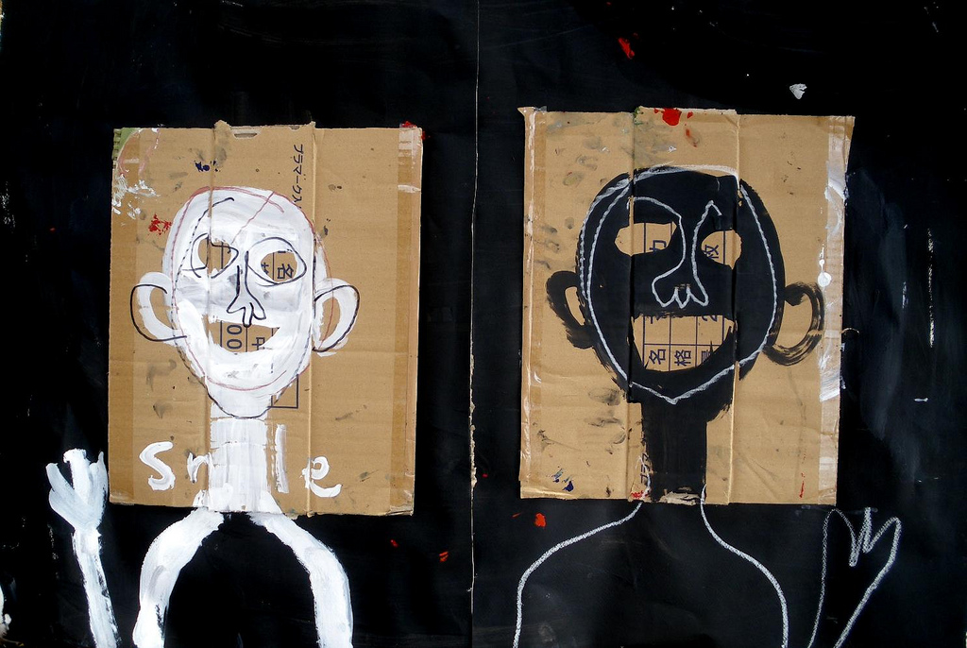

The Nature-Nurture Question
[Instructor Name]
[Class and Section Number]
Notes:
The Nature-Nurture Question chapter can be taught over a single class period.
This slide introduces the Nature-Nurture question and acknowledges its fundamentality by introducing it within the context of two other sources of historical human interest: the mind-body problem and the free will problem. At this point, students should be aware that the nature-nurture question has a rich and lengthy history.
Historical background: This debate has been around for a long, long time. Rene Descartes, a philosopher from ages ago, endorsed the nativist perspective, which states that we are born with some degree of innate knowledge. John Locke, on the other hand, subscribed to the idea of tabula rasa (“blank slate”), which suggests that we are shaped entirely by our experiences – this is known as empiricism.
Discussion question: Do you subscribe to either of these views? Why?
Answers will vary.
Discussion question: What is the nature-nurture question?
Answer: It is an ongoing debate about whether nature (our genes) or nurture (our environment) is most responsible for who we are and how we behave. Some aspects of our behavior feel as though they originate in our genetic makeup, while others feel like the result of our upbringing or our own hard work.
Instructor’s note: Explain how this question relates to the mind-body problem and the free will problem: Three related problems at the borderline of philosophy and empirical science are fundamental to humans’ understanding of our relationship to the natural world: the mind–body problem, the free will problem, and the nature–nurture problem.
Discussion question: What do you think the mind-body problem is? What about the free will problem?
Answers will vary.
Explanation: These great questions have much in common. Everyone, even without reference to science or formal philosophy, can generate intuitions about them via introspection and casual observation of the world. Yet, our intuitions about our relationship with the physical and biological world often feel incomplete and half-seen. We are in control of our actions in some ways, yet bound to our bodies in others; it seems obvious that our consciousness is some kind of property of our physical brains, but still it often feels as though our awareness floats free of raw physicality. This peculiar combination of easy, but incomplete access to our relationship with nature leaves us fascinated and a little obsessed, like a cat that climbs into a paper bag and then out again, over and over, mystified every time by a relationship between inner and outer that it can glimpse but can’t quite grasp.

Slide 2
Overview
Introduction to Nature-Nurture
What Have We Learned?
Notes:
The purpose of this slide is to provide students with an overview of the material that will be covered during the lecture.
Technical Note: These slides may contain simple click animation so that you can focus students’ attention on a particular question, a selection of text, or an image and not have them be distracted by reading ahead. You can either preview the sequence of animation by going through the slides in slideshow view, visiting the animations tab, or reviewing the slide notes. In the notes you will see a cue - (Click) – that corresponds to each animation.
You will also find hyperlinks to outside videos at various places in the slides. These hyperlinks are embedded in text and indicated by color and in the notes section.

Slide 3
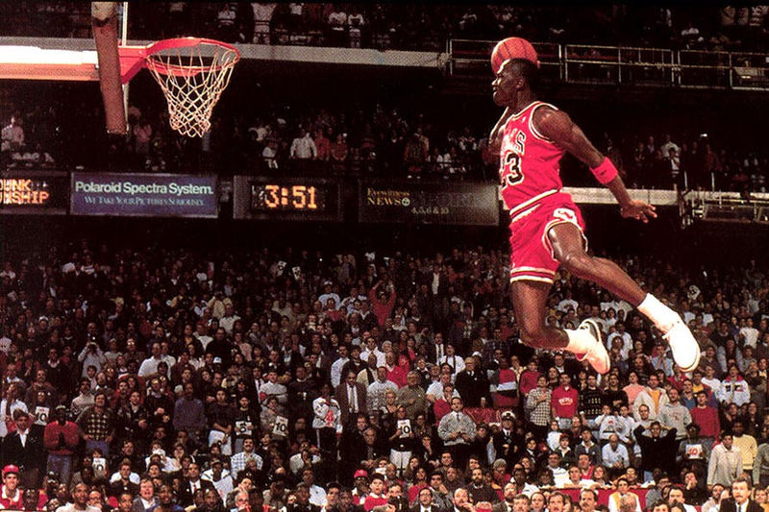
Introduction to Nature-Nurture
Why is the nature-nurture question so fascinating?
Controversial
Fascinating
Consequential
Michael Jordan provides a clear example of the interplay between natural and nurtured talent.
Notes:
This slide explores why humans are so fascinated and invested in the nature-nurture question.
Instructor’s note: Within this discussion, you will explore the complexity of human attributes, emphasizing that consistently they are neither entirely inside or outside our control.
(Click) Discussion question: Why is the nature-nurture question so fascinating?
Student responses will vary.
(Click) Controversial
(Click) Fascinating
(Click) Consequential
Explanation: That some characteristics are inborn while others are acquired is a fundamental and profound human intuition, and it is worth crediting its importance and validity before we begin to pick it apart. Of the three great questions about humans’ relationships with the natural world, only nature–nurture is sometimes called a “debate.” In the history of psychology, no other question has generated so much disagreement and moral indignation: The most fundamental reason we are so fascinated with nature–nurture is that our most important moral judgments seem to depend on it. We may admire the athletic skills of a great basketball player, but his height is simply a gift, a payoff in the “genetic lottery” in which we have all been involuntarily entered. For the same reason no one would condemn a short person, much less someone with a real congenital disability: It is, to state the obvious, “not their fault.” But we do credit the concert oboist for her skills, and perhaps her parents and community as well; we condemn cheaters, slackers, and the violent.
It only adds to our fascination that most interesting human characteristics aren’t actually like height or oboe-playing, with our nature–nurture intuitions skewed strongly one way or the other. Even the great oboist, we might think, might have some inborn quality—perfect pitch, or long nimble fingers—that support and reward her hard work. When we think about ourselves and our ordinary human qualities, they seem under our control in some respects, yet beyond our control in others. Moreover, many of the traits we wonder about are of much greater personal consequence than our height or musicality. What about how much we drink or worry? What about our honesty, our religiosity, or sexual orientation? They all have that same difficult quality, neither fixed by nature nor totally under our own control.
Discussion question: Why is Michael Jordan’s skill at basketball an example of both nature and nurture?
Answer: Michael Jordan, widely considered one of the most naturally gifted American athletes in history, is also well known for diligent practice, spending hours honing his shooting technique. He provides a clear example of the interplay between natural and nurtured talent.

Slide 4

Animal vs. Human Studies
Other Reasons for Our Fascination
Ease of animal study
History of mating experiments
Fast replication
Obstacles to human study
Random assignment impossible
Unethical: eugenics
Could nonaggressive parents have taught this dog to be less aggressive?
Notes:
This slide continues the explanation of why humans are fascinated with/interested in the nature-nurture question by acknowledging that the empirical study of this question is far more difficult in humans than it is in nonhuman animals.
Another reason we are so fascinated with nature–nurture is that there are difficult obstacles in the way of studying it empirically in humans. In nonhuman animals, experimental methods are available that make finding answers to nature–nurture questions relatively straightforward.
Instructor’s note: Begin by sharing the following research example with students: Suppose you are interested in aggressiveness in dogs. You could mate a pair of aggressive dogs and a pair of nonaggressive ones, split their litters in half, and switch half of each litter. You now have puppies born to aggressive and nonaggressive dogs, half of them raised by their own parents, the other half raised by the parents of the opposite type to whom they are not biologically related. Which is a more important determinant of aggression in the puppies: being born to aggressive dogs or being raised by them, and how do the two factors combine? Much of the best and most enduring nature–nurture research has been done in this way (Scott & Fuller, 1998), and animal breeders have been doing it successfully for millennia. It is possible, even easy, to breed animals for behavioral traits.
(Click) Other Reasons for Our Fascination
Discussion question: Why can we do studies like this with animals but not with humans?
Answers:
(Click) Ease of animal study
History of mating experiments
Fast replication
(Click) Obstacles to human study
Random assignment impossible
Unethical: eugenics
Explanation: In people, it is not possible to assign babies to parents at random, or to select parents with certain behavioral characteristics for reproduction. (Although history includes horrific examples of such practices, as part of misconceived attempts at “eugenics,” the shaping of human characteristics through intentional breeding.) In typical human families, the children’s biological parents also raise them, and as a result, it is very difficult to know whether children resemble their parents for genetic or environmental reasons.

Slide 5
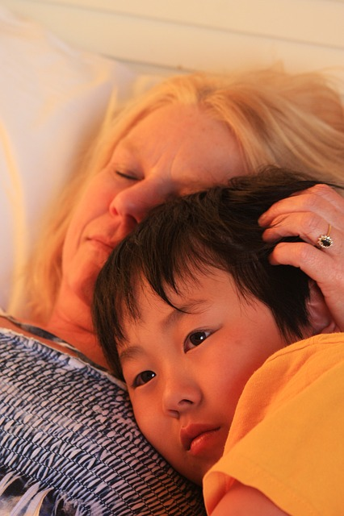
Nature-Nurture Research Methods
Behavioral Genetics – Empirical science of how genes and environments work together
Adoption Studies
Notes:
This slide provides another reason for our fascination with the nature-nurture question. Specifically, despite the fact that, as mentioned in slide 4, there are obstacles to studying the question, these obstacles have led to the development of intriguing ways to gain information regarding this question. Here, the instructor is to introduce behavioral genetics and adoption studies.
Lecture Info:
The next reason for our fascination with nature–nurture is the converse of the previous one: Although there are difficult obstacles in the way of scientific analysis of human families, clever methods exist that provide partial solutions. The empirical science of how genes and environments work together to generate behavior is called behavioral genetics.
(Click) Adoption Studies
The easiest of these methods to understand is the adoption study. When children are put up for adoption, the parents who give birth to them are not the parents who raise them. It isn’t quite the same as the experiments with dogs—children can’t be assigned to adoptive parents at random, or in order to suit some particular interests of a scientist, but adoption still tells us something interesting.
Discussion questions: If the biological children of tall parents were adopted into a family of short people, what do you think would happen? What about the biological children of a Spanish-speaking family adopted at birth into an English-speaking family? Would this tell you something about the difference between height and language?

Slide 6
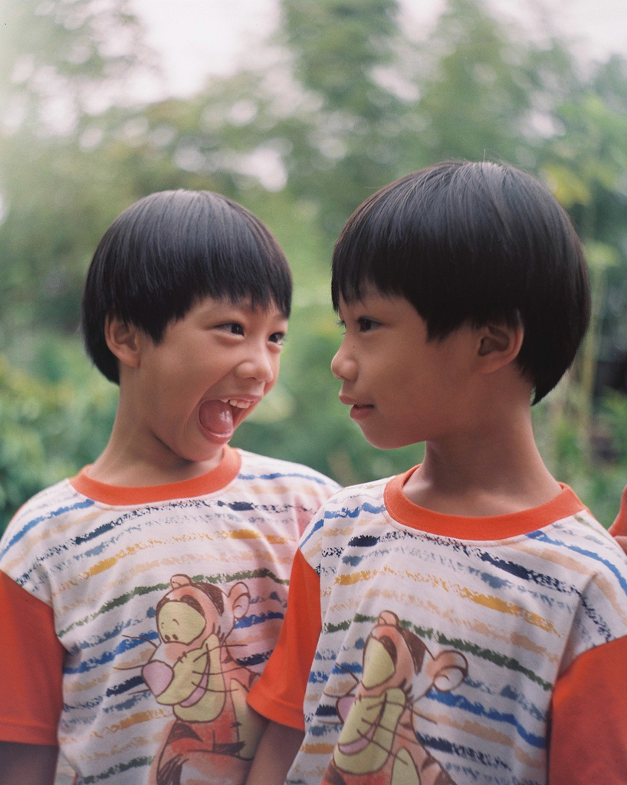

Nature-Nurture Research Methods
Monozygotic Twins Dizygotic Twins
Secret Twin Study
Notes:
This slide complements the discussion from slide 5, as you are to introduce another empirical method derived to circumvent the obstacles to addressing the nature-nurture question: twin studies. Explain the difference between monozygotic and dizygotic twins, and discuss ways in which each may be utilized to gain information relevant to the nature-nurture question.
Instructor’s note: Begin by explaining the basic difference between the two types of twins: Identical, or monozygotic (MZ), twins result from a single zygote and have the same DNA. They are essentially clones. Fraternal, or dizygotic (DZ), twins develop from two zygotes. Fraternal twins are ordinary siblings who happen to have been born at the same time. They share 50% of their DNA.
Discussion question: How might twin studies help us better understand the nature-nurture question?
Answers will vary.
Explanation: To analyze nature–nurture using twins, we compare the similarity of MZ and DZ pairs. Identical twins, unsurprisingly, are almost perfectly similar for height. The heights of fraternal twins are like any other sibling pairs: more similar to each other than to people from other families, but hardly identical. This difference in similarity tells us something about the role genetics plays in the determination of height. Now consider speaking Spanish. If one identical twin speaks Spanish at home, the co-twin with whom she is raised almost certainly does too. But in this case, the same would be true for a pair of fraternal twins raised together. For language-speaking, fraternal twins are just as similar as identical twins, so it appears that the additional genetic similarity of identical twins isn’t making much difference.
Twin and adoption research designs have much in common; in fact, they are two instances of a much broader class of methods in which similarity among individuals is analyzed in terms of how biologically related they are, a scientific discipline called quantitative genetics. We can do these studies with siblings and half-siblings, cousins, or with twins who have been separated at birth and raised separately (Bouchard, Lykken, McGue, & Segal, 1990; such twins are very rare and play a smaller role than is commonly believed in the science of nature–nurture), or with entire pedigrees of extended families.
(Click) Secret Twin Study (hyperlink to video)
Instructor’s note: Consider playing the linked video about the secret study of twins who were separated at birth. Video link: https://www.youtube.com/watch?v=1gwnzW4jOMI. Play the video from 2:35-7:30s. The video touches upon the nature vs. nurture question, emphasizing the nature part of the debate (i.e., similarities between the separated twins) and is a perfect segue into the in-class activity, which offers a different perspective.

Slide 7
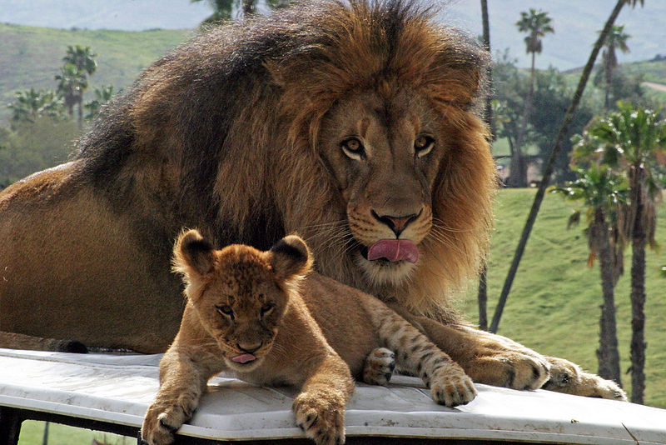
Quantifying Nature-Nurture
Heritability Coefficient – Measures how strongly differences among individuals for a trait are related to differences among their genes
Notes:
This slide introduces the heritability coefficient.
Instructor’s note: You’ll need to explain the role of the heritability coefficient in generating interest in the nature-nurture question.
Lecture Info:
For better or for worse, our thinking about nature–nurture has been intensified because the methods of quantitative genetics produce a number, called a heritability coefficient, varying from 0 to 1, that appears to provide a single measure of the role of genetics in a trait. In a general way, a heritability coefficient measures how strongly differences among individuals for a trait are related to differences among their genes. But beware: The previous sentences are qualified with appears to and in a general way because heritability coefficients, although simple to compute, are deceptively difficult to interpret. Nevertheless, numbers that seem to provide simple answers to complicated questions have a strong draw on the human mind, and a great deal of time has been spent discussing whether the heritability of intelligence or personality or depression is equal to this number or that.
Suggested activity: Striking Similarities Among Strangers – 10-15 minutes (Find the details of this activity in the IM > Biology as a Basis of Behavior > Module Four: The Nature- Nurture Question > Activities/Demonstrations)
Using the handout “Similarities Questionnaire”, students will pair up with someone in class that they don’t know and make note of all the similarities and differences they find.
Discussion questions:
How many similarities did you find between you and your partner?
What might this tell us about the nature-nurture question?
How does this relate to the video we just watched about the twins? What assumptions might we have made about these twins before that this questionnaire encourages us to doubt now? (Answer: We might have assumed that all of the similarities between the separated twins was due to their genetic makeup.)

Slide 8
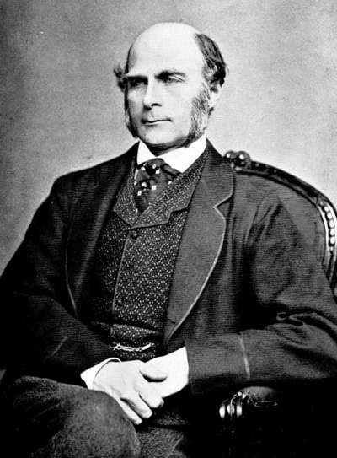
Historical Context
Timeline of Scientific Discovery
Late 1800’s - Francis Galton influenced by cousin, Charles Darwin; begins nature-nurture debate
Early 1900’s - Gregor Mendel’s genetic work with peas realized as important
1920’s – Quantitative genetics developed
1950’s – DNA discovered by Watson and Crick
Early 2000’s – Human genome sequenced
Sir Francis Galton coined “eugenics” and “nature versus nurture”.
Notes:
This slide introduces the importance of recent scientific discovery in the area of genetics. Pictured is Francis Galton, credited with contributing to the introduction of the nature-nurture debate.
Instructor’s note: Provide the following historical context to help students further understand why we continue to be fascinated by the nature-nurture debate.
Historical explanation: The final reason nature–nurture has continued to fascinate us is that we live in an era of great scientific discovery in genetics, the equal, certainly, of the time of Galileo, Copernicus, and Newton with regard to astronomy and physics.
(Click) Late 1800’s - Francis Galton influenced by cousin, Charles Darwin; begins nature-nurture debate
When Francis Galton first started thinking about nature–nurture in the late-19th century, he was very influenced by his cousin, Charles Darwin, but genetics per se was unknown.
(Click) Early 1900’s - Gregor Mendel’s genetic work with peas realized as important
Mendel’s famous work with peas, conducted at about the same time, went undiscovered for 20 years.
(Click) 1920’s – Quantitative genetics developed
(Click) DNA discovered by Watson and Crick in the 1950s.
(Click) The human genome was completely sequenced at the turn of the 21st century; and we are now on the cusp of a time when it will be possible to obtain the DNA sequence of anyone at relatively low cost. No one knows what this new genetic knowledge will mean for the study of nature–nurture, but as we will see in the next section, answers to nature–nurture questions have turned out to be far more difficult and mysterious than anyone imagined.

Slide 9
Overview
Introduction to Nature-Nurture
What Have We Learned?
Notes:
The purpose of this slide is to provide an overview of the material that will be covered during the lecture.

Slide 10
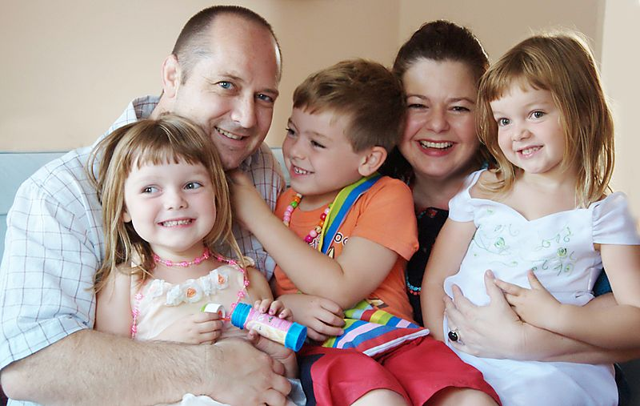
What Have We Learned?
Genetic Relation → Similarity
Notes:
In this slide, you will present findings relevant to the role of genetics in the nature-nurture question. Quite simply, the more genetically related one person is to another, the more these two people will share in common.
Lecture Info:
It would be satisfying to report that the proliferation of scientific nature–nurture studies has produced a finely articulated set of results, with some traits turning out to be under strong genetic control, leading to clear genetic explanations of their development, while others turned out to be relatively independent of genes, in the domain of parental childrearing practices and the force of our personal will; but that is not what has occurred. Instead, everything has turned out to be related to genetics in this sense:
The more genetically related people are, the more similar they are, and for everything—height, weight, intelligence, personality, mental illness. Adopted children resemble their biological parents even if they have never met them; identical twins are more similar than fraternal twins. This finding is true not only for the classical psychological traits such as personality and psychiatric categories such as schizophrenia: It is also true for political attitudes, how much television people watch (Plomin, Corley, DeFries, & Fulker, 1990), and whether or not they are divorced (McGue & Lykken, 1992).

Slide 11

Lesson: Much Is Left To Learn
Genes
Environment
Notes:
This slide provides an opportunity for the instructor to acknowledge what we presently do not know. It is unclear, at the moment, exactly what the shared influence of genetic and environmental variables are within the context of behavioral traits. However, it is true that both likely exert an influence, and thus you cannot leave out either when considering the origins of behavioral traits.
Instructor’s note: Share the following historical information as a way of illustrating how our ideas about environment versus heredity have changed over time and are still evolving.
People have grown accustomed to the idea of genetic influence on behavioral characteristics, and it may be difficult to imagine how shocking it was when these discoveries were first made.
In the middle of the 20th century, psychology was dominated by the doctrine of behaviorism (Skinner), which held that the behavior of organisms could be explained only in terms of environmental contingencies, without reference to internal states.
Psychiatry was dominated by psychoanalysis (Freud), which sought explanations of behavior in the early life-histories of individuals.
Discussion question: What assumptions are each of these frameworks making, and what’s missing from them?
Answers will vary, but you’ll want students to understand that both behaviorism and psychoanalysis are focusing to closely on one theory of human behavior. They don’t consider other variables that may affect a subject’s behaviors.
Explanation: Neither behaviorism nor psychoanalysis is incompatible with genetic influences on behavior, and neither Freud nor Skinner was naive about the importance of organic processes in the genesis of behavior. Nevertheless, it was widely thought at the time that children’s personality was shaped by modeling the observed behavior of their parents and that schizophrenia was caused by certain kinds of pathological mothering.
Discussion question: Considering what we’ve learned about the link between genetic relation and similarity, what can we assume about the importance of nature and nurture when attempting to understand human behavior?
Answer: The best predictors of an adopted child’s personality or mental health are to be found in the biological parents he or she has never seen, rather than in the adoptive parents who raised him or her. To this extent the outcome of nature–nurture has been clear: You can’t leave out genes. Of course, no human behavioral traits are perfectly heritable, so the converse is also true: You can’t leave out the environment. However complicated relations among genes, environments, and behavior may turn out to be, it is never possible to interpret an association between the behaviors of biologically related individuals as causal and environmental in origin without further evidence.
Example: This may seem obvious, but it is always very tempting to observe that mothers who read more to their children have children with better reading scores in the third grade and to conclude that reading out loud is important to success in school. It may well be, but the study as described is inconclusive, because there are genetic as well as environmental pathways between the parenting practices of mothers and the abilities of children. To establish that reading aloud causes success, a scientist can either study the problem in adoptive families in which the genetic pathway is absent or by finding a way to assign children at random to oral reading conditions.

Slide 12

Lesson: Avoid Making Assumptions
Notes:
This slide provides a specific example of an incorrect conclusion that might be drawn regarding the unique contributions of genetics and environment within the context of a specific traits (i.e., having two arms). By providing this information, you are cautioning students from making assumptions about the unique influence of each.
Discussion question: Can you think of any human traits that seem to be totally genetic, without any influence from the environment?
Answers will vary. Use this as an introduction to the two-arm example that illustrates how difficult it is to separate genetic and environmental influences.
Explanation: The classic example is the trait of having two arms. No one would doubt that the development of arms is a profoundly biological and genetic process. But fraternal twins are just as similar for two-armedness (that is to say, nearly perfectly similar) as identical twins, and as a result the heritability of having two arms is essentially zero. This result is not a tip-off that arm development is less genetic than we had imagined, rather it occurs because people do not vary in the genes related to arm development. To the extent people do differ in arm number, it is likely the result of accidents and, therefore, environmental. For this reason, we always have to be very careful when asking nature–nurture questions and especially when we try to express the answer in terms of a single number. The heritability of a trait is not a property of that trait, it is a property of the trait in a particular context in which relevant genes and environments vary in some ways but not in others.
Discussion question: What do you think “gene-environment interaction” means? When might a gene have an environmental/behavioral effect?
Answer: For many traits, genetic differences affect behavior under some environmental circumstances but not others, a phenomenon called gene-environment interaction, or G x E. In one well-known example, Caspi et al. (2002) showed that among maltreated children, those who carried a particular allele of the MAOA gene showed a predisposition to violence and antisocial behavior, while those with other alleles did not. The gene had no effect in children who had not been maltreated. Making matters even more complex are very recent studies of what is known as epigenetics (see module, “Epigenetics”), a process in which the DNA itself can be modified by environmental events, and those changes transmitted to children.

Slide 13

Lesson: Some Traits Are Malleable
Notes:
The purpose of this slide is to discuss the potential malleability of seemingly immutable traits.
Discussion question: What are some common behaviors or traits that we often consider to be a choice? What kinds of traits seem to be immutable, or unchangeable?
Answers will vary. Use this as a transition into discussing two examples of seemingly immutable traits that are actually malleable.
Phenylketonuria - an inborn error of metabolism caused by a single gene; it prevents the body from metabolizing phenylalanine. Untreated it causes mental retardation and death, but it can be treated effectively by a straightforward environmental intervention: avoiding foods containing phenylalanine.
Height – While height seems like a trait about which we have no choice, something that is firmly rooted in our nature, the average height of many populations of people in Asia and Europe has increased massively in the past 100 years. Such rapid change cannot be genetic; instead it is the result of changes in diet and alleviation of poverty.
Further explanation: For most traits, there are a few rare genes with large (almost always negative) effects, such as the single gene that causes Huntington’s disease or the Apolipoprotein gene that causes early dementia in a small percentage of cases of Alzheimer’s disease. Beyond these rare genes of large effect, however, genetic effects on behavior are broken up over many genes, each with very small effects. For most behavioral traits, the effects are so small and distributed across so many genes that we have not been able to catalog them in a meaningful way. In fact, the same is true of environmental effects. We know that extreme environmental deprivation causes catastrophic effects for many behavioral outcomes, but fortunately extreme environmental deprivation is very rare. The environmental events responsible for differences in the normal range—why some children in a suburban third-grade classroom perform better than others—are much more difficult to discern.

Slide 14

Lesson: It’s Complicated
Notes:
Conclude the lecture with a summary. The instructor should emphasize the contrast between the perceived simplicity of the nature-nurture question with the true complexity of what is at the heart of the inquiry. Pictured is a Celtic maze, well known for its assumed simplicity but ultimate impossibility/complexity (there is no entrance).
Discussion question: Now that we’ve studied nature-nurture more closely, how have your initial ideas about this debate changed?
Answers will vary.
Main lessons to share with students:
What at first appears to be a straightforward distinction that might be indexed with a single number, as with the heritability coefficient, becomes more and more multifaceted the closer we examine it.
The many questions we can ask about the relationships among genes, environments, and human traits—how sensitive are traits to environmental change, and how common are the environments to which they are sensitive; whether parents or the broader cultural environment are more relevant; how sensitive traits are to differences in genetic endowment, and how much do the relevant genes vary in a particular population; whether a single gene or a great many genes are involved; whether a trait is more easily described in genetic or more complex behavioral terms—all these questions may have different answers, and the answer to one tells us little about the answers to the others.
Our knowledge of the profound and wide-ranging effects of genetic differences on all human characteristics has real-world implications:
Perhaps criminal proceedings will have to consider genetic background.
Parents, presented with the genetic sequence of their children, will be faced with difficult decisions about reproduction.
In some ways, our thinking may need to change, especially if it was once informed by a superficially empirical reading of the great American principle that all men are created equal. Human beings differ, and like all evolved organisms they differ genetically. The Declaration of Independence predates Darwin and Mendel, but it is hard to imagine that Jefferson-- whose genius encompassed botany as well as moral philosophy-- would have been alarmed to learn about the genetic diversity of organisms.
The science of nature and nurture has demonstrated that genetic differences among people are integral to human moral equality, freedom, and self-determination, not opposed to them. As Mordecai Kaplan said about the role of the past in Jewish theology, genetics gets a vote, not a veto, in the determination of human behavior. We should indulge our fascination with nature–nurture while resisting the temptation to oversimplify it.

Slide 15
Photo Attribution
Slide 1 | Photo Credit: Shohei Hanazaki https://www.flickr.com/photos/7291585@N02/4626350622/" https://creativecommons.org/licenses/by-nc-nd/2.0/
Slide 3 | Photo Credit: Diegoestefano97 http://upload.wikimedia.org/wikipedia/commons/f/fc/Michael-jordan.jpg http://creativecommons.org/licenses/by-sa/3.0/deed.en
Slide 4 | Photo Credit: U.S. Air Force Photo by Josh Plueger. Postwork by Dove http://upload.wikimedia.org/wikipedia/commons/e/e7/Mad_dog.jpg http://en.wikipedia.org/wiki/en:public_domain
Slide 6 | Photo Credit: evilpeacock https://www.flickr.com/photos/74637221@N00/8604625969/ https://creativecommons.org/licenses/by-nc-sa/2.0/
Slide 6 | Photo Credit: ethermoon https://www.flickr.com/photos/10763572@N03/4045176015/ https://creativecommons.org/licenses/by-nd/2.0/
Slide 7 | Photo Credit: Ben Pollard http://upload.wikimedia.org/wikipedia/commons/6/69/Like_Father_like_Son.jpg http://creativecommons.org/licenses/by-sa/2.0/deed.en
Slide 8 | Photo Credit: http://commons.wikimedia.org/wiki/File:Francis_Galton_1850s.jpg http://en.wikipedia.org/wiki/en:public_domain
Slide 10 | Photo Credit: Catherine Scott http://upload.wikimedia.org/wikipedia/commons/5/5e/Happy_family_%281%29.jpg http://creativecommons.org/licenses/by-sa/2.0/deed.en
Slide 11 | Photo Credit: Made by PP Author
Slide 12 | Photo Credit: Zero Style https://www.flickr.com/photos/76095197@N00/51362386/ https://creativecommons.org/licenses/by-nc-nd/2.0/
Slide 13 | Photo Credit: Jeff Kubina http://commons.wikimedia.org/wiki/File:Blacksmith_working.jpg http://creativecommons.org/licenses/by-sa/2.0
Slide 14 | Photo Credit: http://upload.wikimedia.org/wikipedia/commons/9/99/Celtic_spiral_tile_pattern.png http://creativecommons.org/licenses/by-sa/3.0/deed.en

